Slide 1
GROUP 22
Lovely Digra IIT2017090
Abhishek Vishwakarma IIT2017091
Anuj Raj IIT2017092

Slide 2
Problem Statement
Our required aim is to design an algorithm to trace
the movements of each element and values held by all nodes in a heap.

Slide 3
Introduction
A special kind of binary tree that follows a strict set of rules,
and are used to implement things like priority queues and
background jobs. But these aren’t the only thing that heaps
are good for. It turns out that binary heaps are often used
for no other purpose than efficient sorting. Many programs
will rely on heap sort since it happens to be one of the most
efficient ways to sort an array. They are of two kinds: Min
Heap and Max heap. For this problem we would be talking
about min heap. Therefore, further discussion consider heap
as min heap. In a Min-Heap the key present at the root node
must be minimum among the keys present at all of its children.

Slide 4
The same property must be recursively true for all sub-trees
in that Binary Tree. Similarly, for max heap the key present
in max heap at the root node must be greatest among the
keys present at all of its children. The same property must be
recursively true for all sub-trees in that Binary Tree.

Slide 5
Algorithm
Heap data structure are be implemented generally in two
ways. One is nodes tree structure and the other is arrays.
Implementation in arrays is widely used because of its easy
implementation and space efficiency. Thus the later implemen-
tation is followed in the proposed algorithm. Input elements
are stored in normal array. Then the array is converted to heap.
Array to heap conversion is done using two sub programs.
Heapify and Build-Heap. The movement of each node while
building heap(min heap) . This problem can be solved in two
ways either by using iterative approach or by implementing
recursive method.

Slide 6
Approach 1: Using Recursion
Let an arr[0...n-1] be an input array of size ’n’ which stores
elements of heap. To trace the movements of each elements
and values held by all nodes in a heap first there is need
to build heap for that call function build heap(). As, heap
is almost complete binary tree which means there are two
types of nodes that are leaf nodes and non-leaf nodes. And we
know that leaf nodes are nodes whose left and right children
are null. Therefore, leaf nodes always satisfy the condition of
min heap. Thus in build heap() function iterate an array from
last non-leaf node to the root of heap and call min heapify()
function for each element. In min heapify() function calculate
index of left and right children and compare their value with
key. And now, check the key present at the current root node
must be minimum among the keys present at all of its children.

Slide 7
The same property must be recursively true for all sub-trees
in that Binary Tree. If not so then swap the key with the
smallest element and print the heap to track the movements
of each element in a heap. As heap is modified now you need
to check for its left and right sub-trees whether they satisfy
the condition of min heap or not for that call min heapify()
function on the location of smallest element. At last, print the
final created heap that is min heap.
This approach is similar to iterative approach but there is a
bit difference that is in recursion as we need to call function
again and again which consumes a lot of space complexity.
In this case space complexity taken by min heapify() function
is o(log(n)) but in case of iterative approach there is a base
condition instead of calling function again and again.

Slide 8
Approach 2: Using iterative method
The optimized solution of this problem is Iterative approach.
Similar to recursive approach take input from user in an array
format and for building heap call build heap() function. But there
is a difference in min heapify() function. In case of iterative approach
there is a base condition which need to be checked every
time that is location of smallest element should
be always less than the size of actual heap if not so then come
out of the loop otherwise keep updating the value of smallest
position with the index of smallest element out of left or right
child. And at last, print the final min heap.

Slide 9
Pseudo Code(Iterative)
procedure MIN HEAPIFY (int A[], int size, int pos)
smallest ← pos
while pos < size do
lef t ← 2 ∗ pos + 1
right ← 2 ∗ pos + 2
if left < size and A[left] < A[smallest] then
smallest ← left
if right < size and A[right] < A[smallest] then
smallest ← right
if smallest != pos then
temp ← A[pos]
A[pos] ← A[smallest]
A[smallest] ← temp
Print the array
pos ← smallest
else
break
procedure BUILD H EAP (A[], size)
s ← (size/2) − 1
for I from s → 0 do
minheapify(A, size, I)
procedure MAIN
Taking the inputs
Calling buildHeap()

Slide 10
Pseudo Code (Recursive)
procedure MIN HEAPIFY (int A[], int size, int pos)
smallest ← pos
lef t ← 2 ∗ pos + 1
right ← 2 ∗ pos + 2
if left < size and A[left] < A[smallest] then
smallest ← left
if right < size and A[right] < A[smallest] then
smallest ← right
if smallest ! = pos then
temp ← A[pos]
A[pos] ← A[smallest]
A[smallest] ← temp
Print the array
minHeapify(A, size, smallest)
procedure BUILD HEAP (A[], size)
s ← (size/2) − 1
for I from s → 0 do
minheapify(A, size, I)
procedure M AIN
Taking the inputs
Calling buildHeap()

Slide 11
Experimental Analysis
For the experimental analysis of this algorithm, we will take
size of an array(n) as an input and plot a
graph of size of array vs execution time. A .dat file is
generated.

Slide 12
Time Complexity Discussion
In the algorithm design section, it is discussed that array is
converted into Heap (min Heap). This is done using the by
applying buildHeap and minHeapify. Every time when there
is a swap that is there is a movement of elements in the array,
it is traced by printing the array after the swap. Thus time
complexity of the algorithm will be no. of swaps x complexity
of the printing the whole array of size n.

Slide 13
No. of swaps is actually time complexity of BuildHeap.Time
complexity of buildHeap is O(n). This can be understood
using following facts. Heap is a complete binary tree in which
every level except the last one has n/(2^h + 1) elements. All the n/2
leaf nodes are already heaps of size 1.The next level has n 4
nodes which can have maximum of one swaps.This goes like:
1.n/4 + 2.n/8 + … + (h.1)= n
Thus worst case total complexity of the algorithm is O(n^2 ).

Slide 14
Best case can be the case when the input is already in min Heap.
In that case, time complexity only depends number of times the heapify
function is called in the build heap function. i.e n/2 − 1.
Space Complexity: recursive algorithm has a runtime stack
overhead of O(log n), but this has been improved by iterative
algorithm . Therefore, space complexity is O(1).

Slide 15
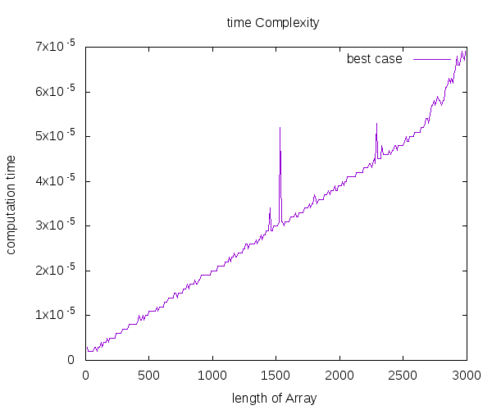
Graph(Best Case)

Slide 16
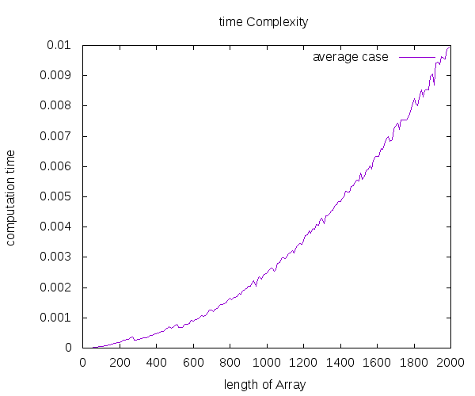
Graph(Average Case)

Slide 17
Conclusion
We designed an algorithm to trace the movements of
each elements and values held by all nodes in a heap. We
also analyzed the algorithm that resulted in general time
complexity of O(n 2 ) and plotted the graph of size of an array
vs time elapsed and found that the nature of graph is convex.

Slide 18
Thank You!

